Slide 1
ECE 465
Digital Systems Design
Fall 2023
Quine-McClusky using Python
Drumil Panchal (NetID: dpanc6)

Slide 2


Motivation
Reducing the complexity of digital circuits is essential to:
Minimize cost
Lower power consumption
Improve performance
Personal motivation:
Career in VLSI design
Systematic method to minimize Boolean equations
Important concept in EDA

Slide 3


Problem Statement
Minimization techniques such as K-maps become complex when number of variables increase.
Ensuring all prime implicants are considered without redundancy.
Critical in areas like VLSI design
Why Quine-McClusky
Systematic approach
Can handle large number of variables
Computer based
Doesn’t require pattern recognition

Slide 4



Techniques
Methodology:
Input parsing
Prime implicant generation
Prime implicant chart
Formation of expression
Output on GUI
Key features:
User friendly
Scalable
File handling
GUI for better visualization

Slide 5
Literature review
Optimization of the Quine-McCluskey Method for the Minimization of the Boolean Expressions: Minimization using K-map gets complex as the number of variables increases, and the traditional QM method gets computationally expensive when variables increase. Hence, this paper proposes an optimized Quine-McClusky method that reduces the run time complexity of the algorithm by proposing an efficient algorithm for determining Prime Implicants.
A Fully Implicit Quine-McCluskey Procedure Using BDDs: This paper presents an exact method for minimizing logic functions using BDDs to represent our functions. This approach differs from the classical approach in that it exploits the properties of the BDD data structure and the properties of a new extended space that they define to implicitly compute the Primes, Minterms and Covering table for the Quine-McCluskey procedure.

Slide 6
Quine-McCluskey algorithm on GPU: This paper deals with the parallelization of the Quine–McCluskey algorithm. This Boolean function minimization algorithm has a limitation when dealing with more than four variables. The problem computed by this algorithm is NP-hard, and the algorithm’s runtime grows exponentially with the number of variables. The goal is to show that parallel implementation of the Quine–McCluskey algorithm on graphics processing units (GPUs) brings significant acceleration of the computing process.
An Improved Quine-McCluskey Algorithm for Circuit Minimization: This paper revises the Quine-McCluskey Algorithm for circuit minimization problems. Quine-McCluskey method repeatedly finds the prime implicant and employs additional procedures such as trial-and-error, branch-and-bound, and Petrick’s process as a means of circuit minimization. On the contrary, the proposed algorithm produces an implicant chart beforehand to simplify the search for the prime implicant. In addition, it determines a set cover to streamline the search for 1st and 2nd essential prime implicants. When applied to 3-variable and 4-variable experimental data, the proposed algorithm has obtained the optimal solutions much more simply and accurately than the Quine-McCluskey method.

Slide 7
Software Implementation of the Quine-McCluskey Algorithm for Logic Gate Minimization: In this paper, a menu-driven keyboard-based software package has been developed in C language under MS Windows to implement the Q-M algorithm for logic gate minimization. Based on user input (i.e., logic expression), the system displays the sum of product (SOP) functions and minimized logic gates diagram. The experimental results demonstrate successful implementation, and the simplicity of the user interface makes the package a useful teaching and learning tool for both students and tutors.

Slide 8
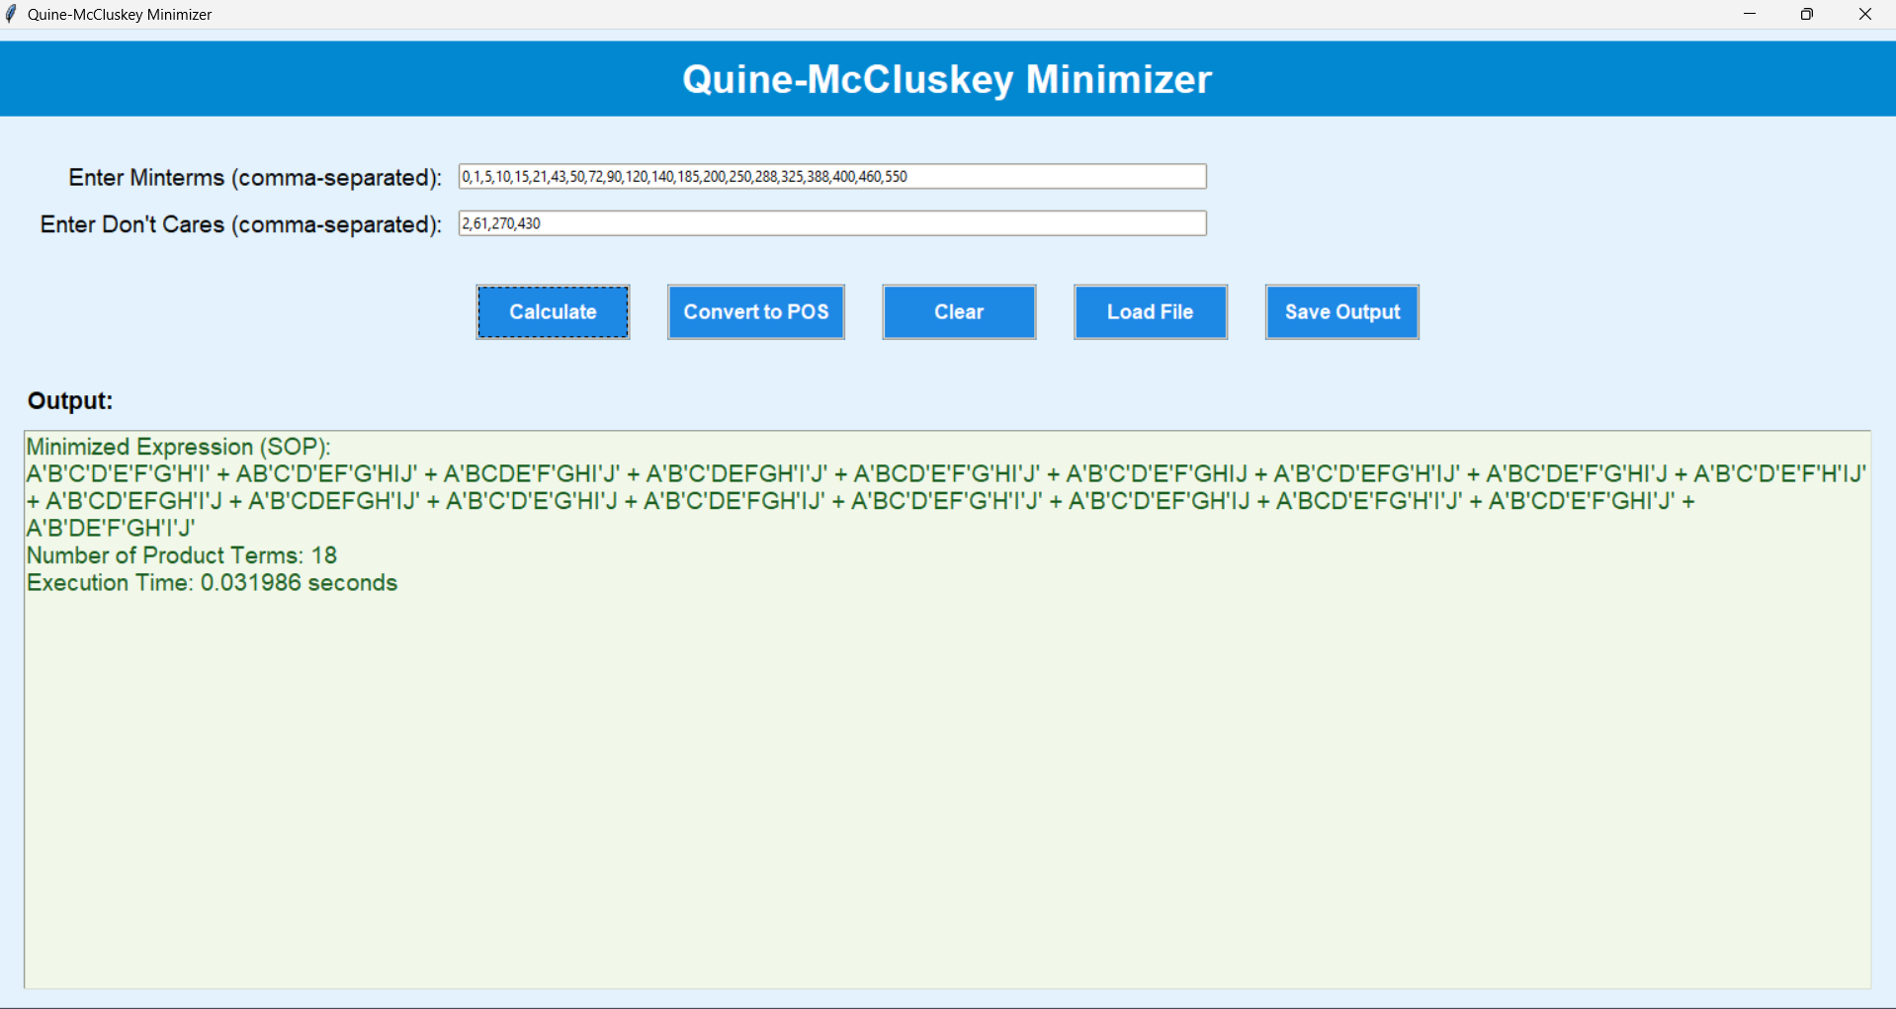
Result 1 – my program

Slide 9
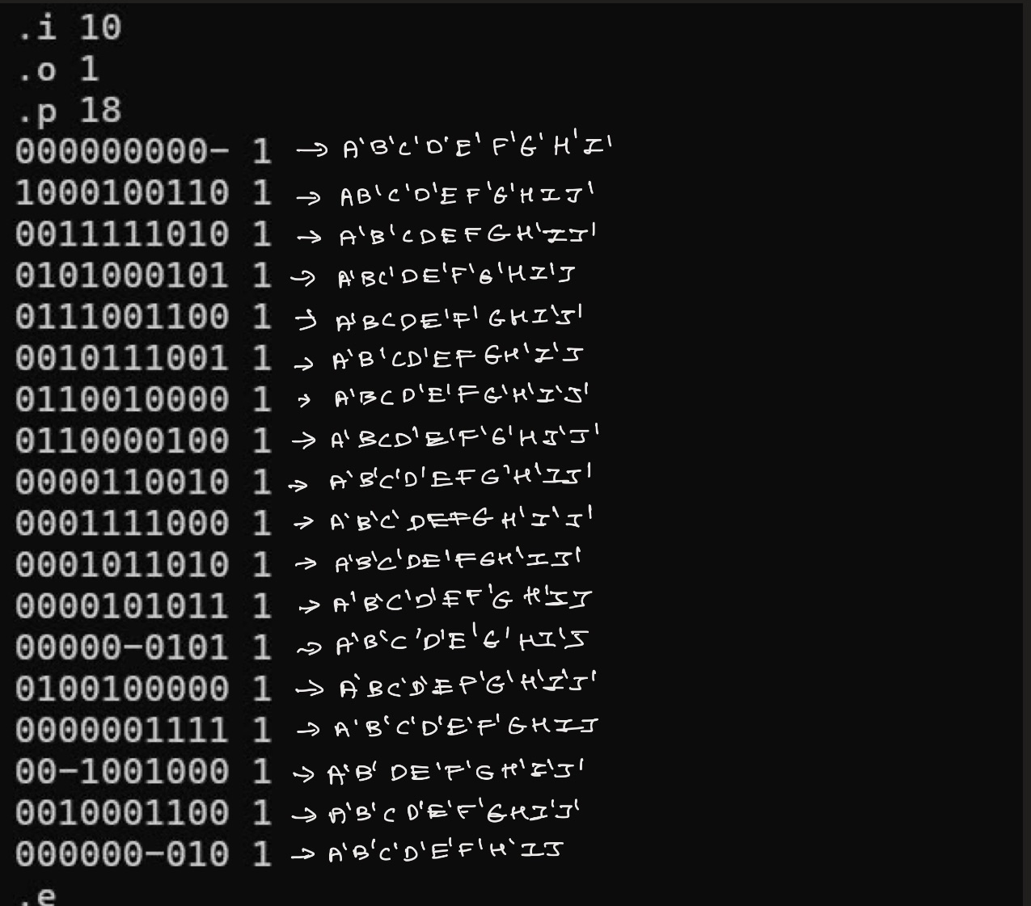
Result 1 – espresso

Slide 10
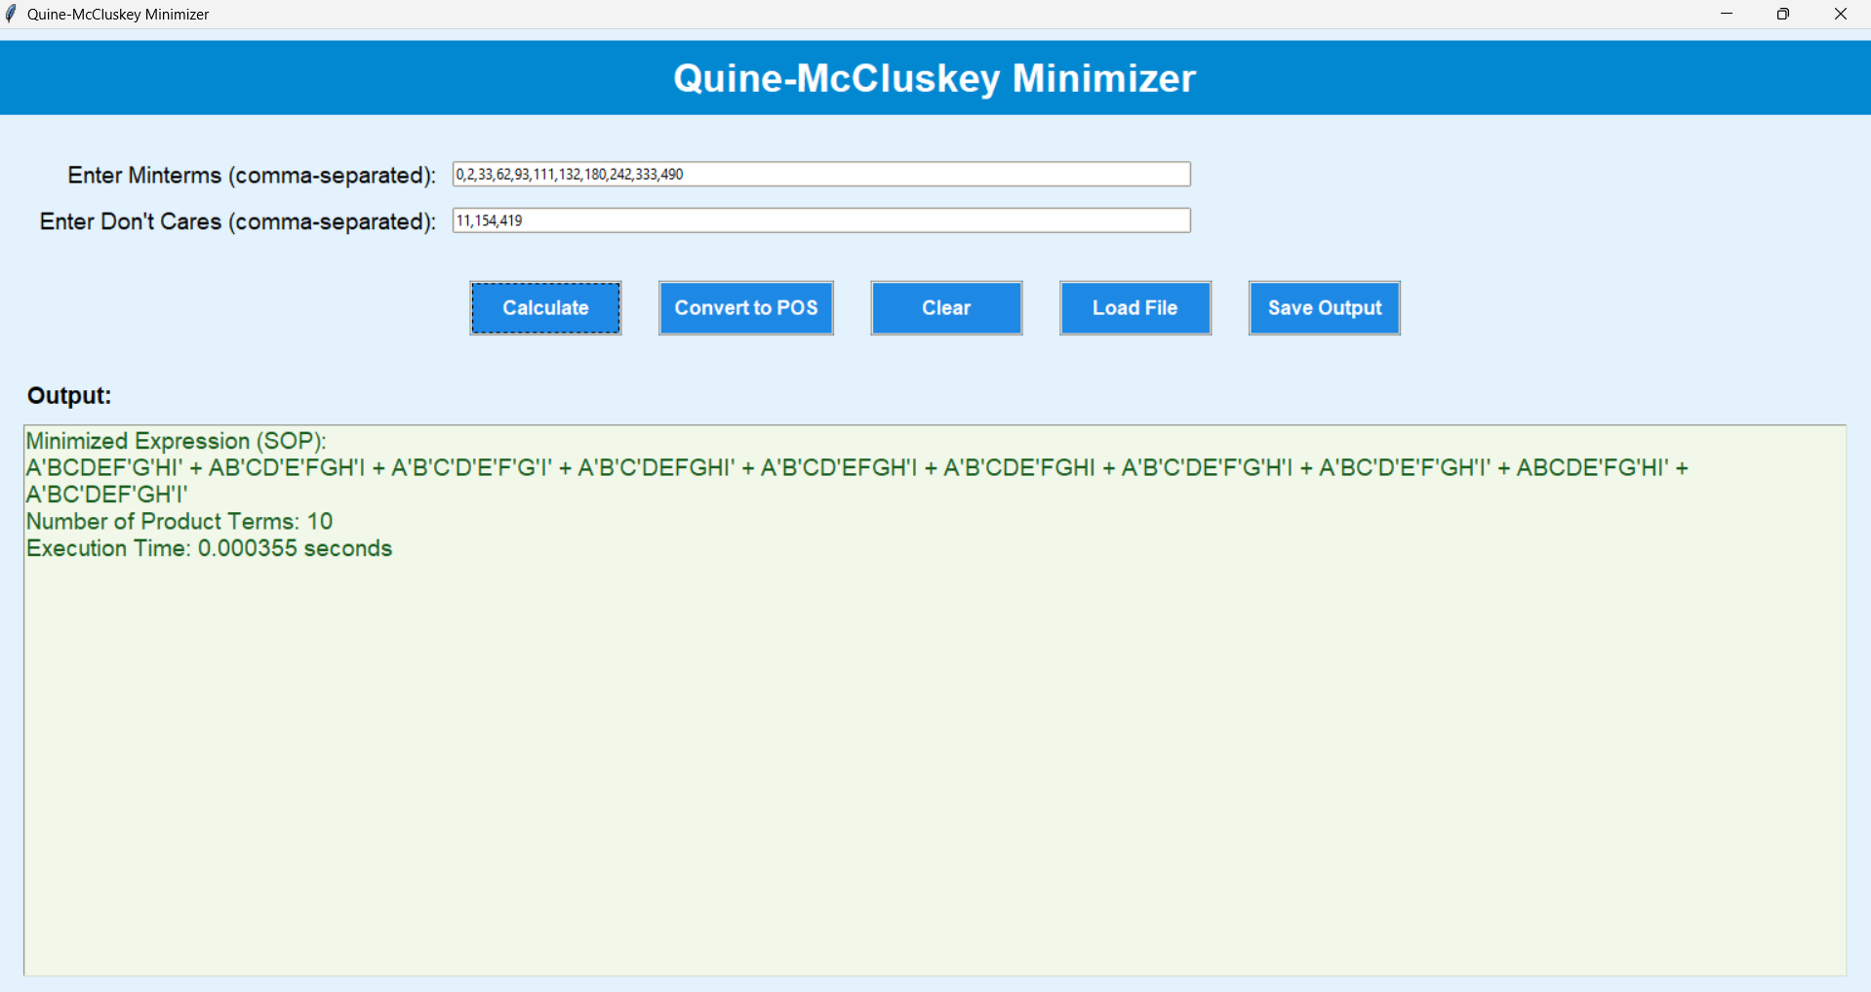
Result 2 – my program

Slide 11
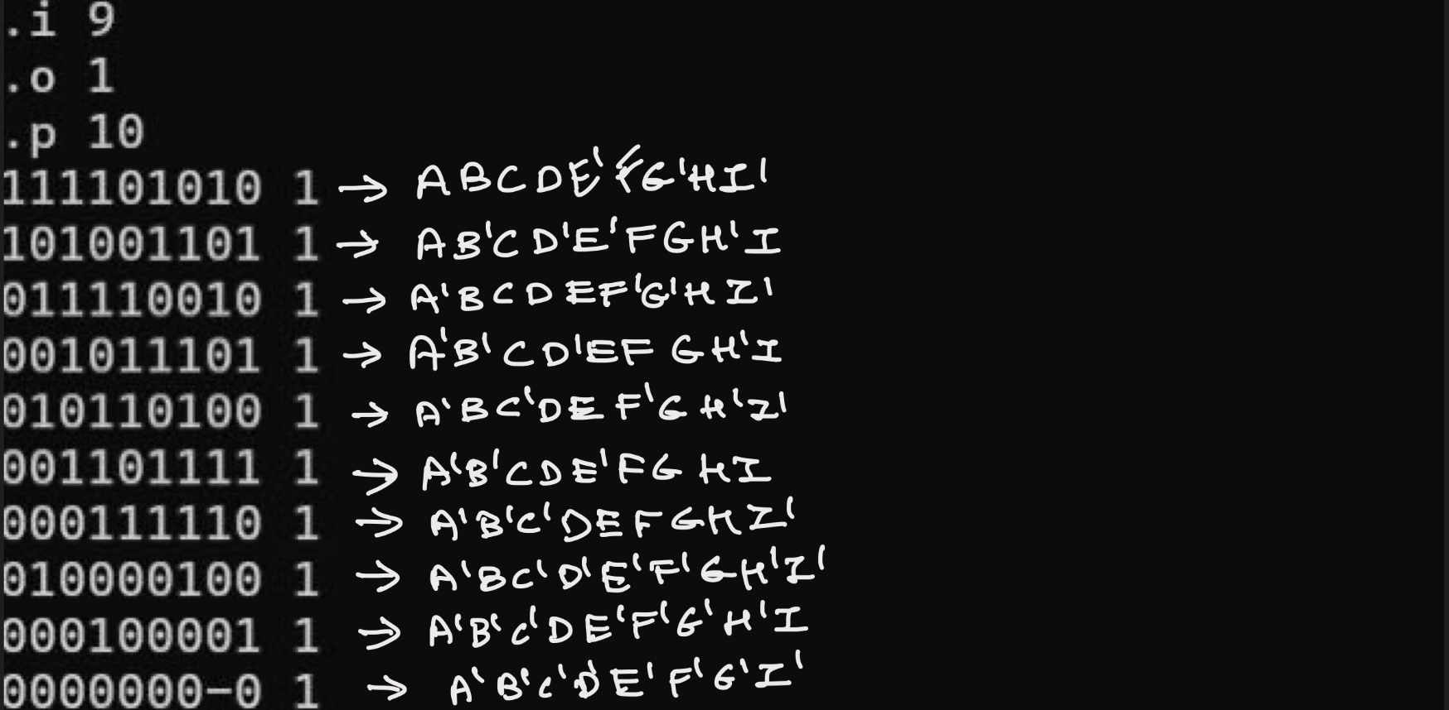
Result 2 – espresso

Slide 12
Conclusion
Successfully implemented the Quine-McCluskey method using Python.
The project bridges theoretical concepts with practical applications in digital design.
Demonstrates the importance of algorithmic problem-solving in simplifying complex logic systems

Slide 13
Reference
T. K. Jain, D. S. Kushwaha and A. K. Misra, "Optimization of the Quine-McCluskey Method for the Minimization of the Boolean Expressions," Fourth International Conference on Autonomic and Autonomous Systems (ICAS'08), Gosier, France, 2008, pp. 165-168, doi: 10.1109/ICAS.2008.11.
Swamy, Gitanjali, A Fully Implicit Quine-McCluskey Procedure Using BDD’s (November 10, 1992).
Siládi V., & Filo T. Quine-Mccluskey algorithm on GPGPU. AWERProcedia Information Technology & Computer Science. [Online]. 2013, 04, pp 814-820.
Lee, Sang-Un, “An Improved Quine-McCluskey Algorithm for Circuit Minimization,” Journal of the Korea Society of Computer and Information , vol. 19, no. 3, pp. 109–117, Mar. 2014.
Sarkar, Nurul, Khaleel Petrus, and Hosneara Hossain. "Software Implementation of the Quine-McCluskey Algorithm for Logic Gate Minimisation." Proceedings of the NACCQ (2001): 375-378.

